Slide 1
Autonomous Negotiation Agents
Modeling Opponent
Presented by: Omer Shani, Noam Kazum | Dr. Raz Lin, Dr. Galit Haim

Slide 2
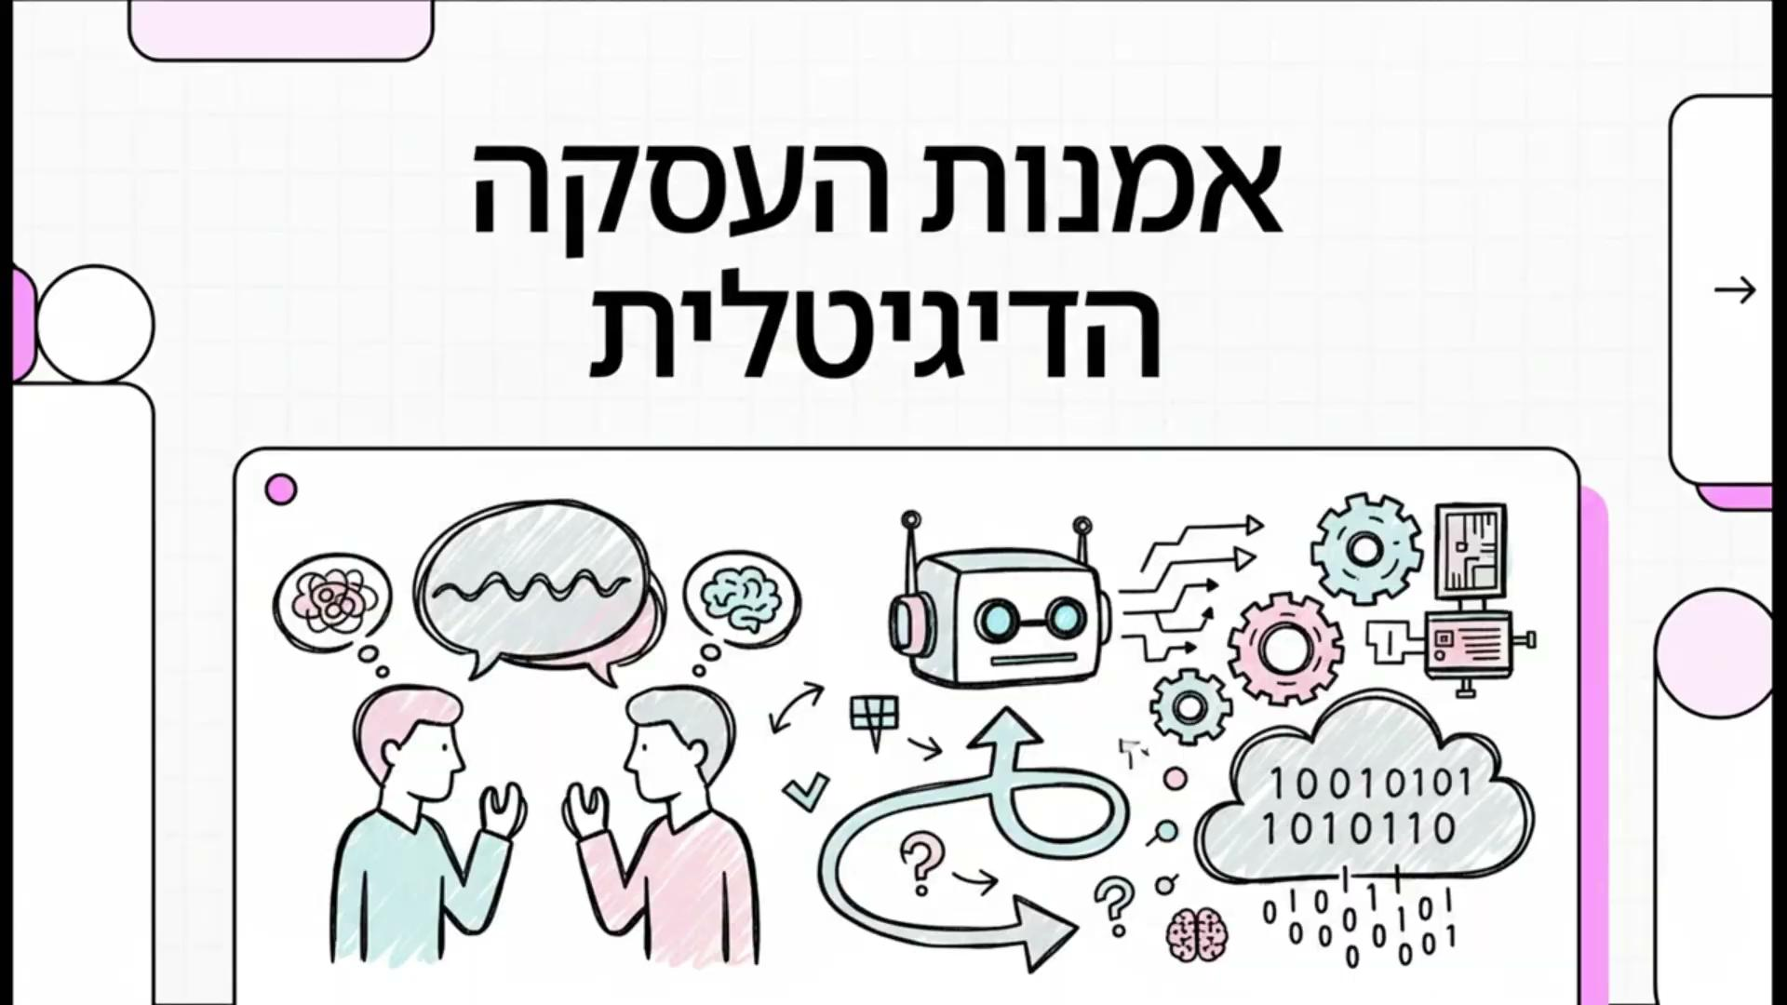

Slide 3
Foundations of Autonomous Negotiation
Aim - solve conflict of interest between agents efficiently and optimally

Slide 4
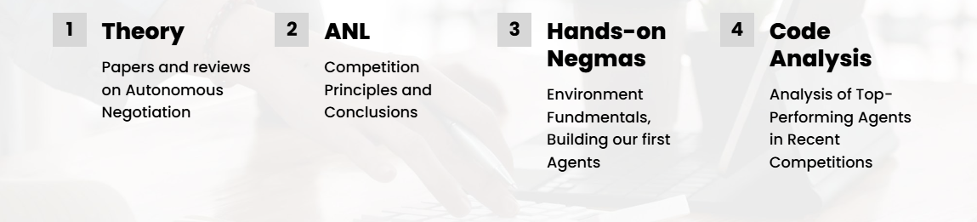
Research Methodology

Slide 5
ANL Competition & NegMAS Environment
Automated Negotiation League (ANL)
Premier global event for benchmarking autonomous negotiators
Focuses on bilateral and multi-deal scenarios
Negotiation Multi-Agent System (NegMAS)
Python library providing the environment for agent development
Framework of ground rules for negotiation

Slide 6
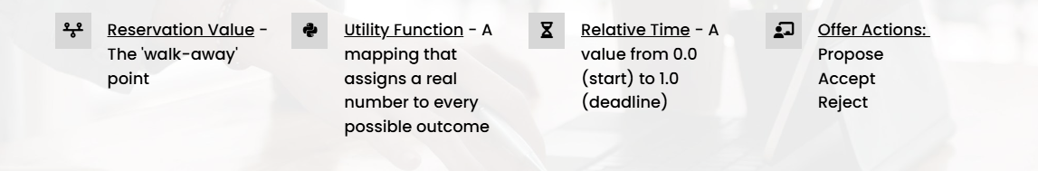
Basic Concepts
Reservation Value - The ‘walk-away’ point
Relative Time - A value from 0.0 (start) to 1.0 (deadline)
Utility Function - A mapping that assigns a real number to every possible outcome
Offer Actions - Propose, accept, reject

Slide 7
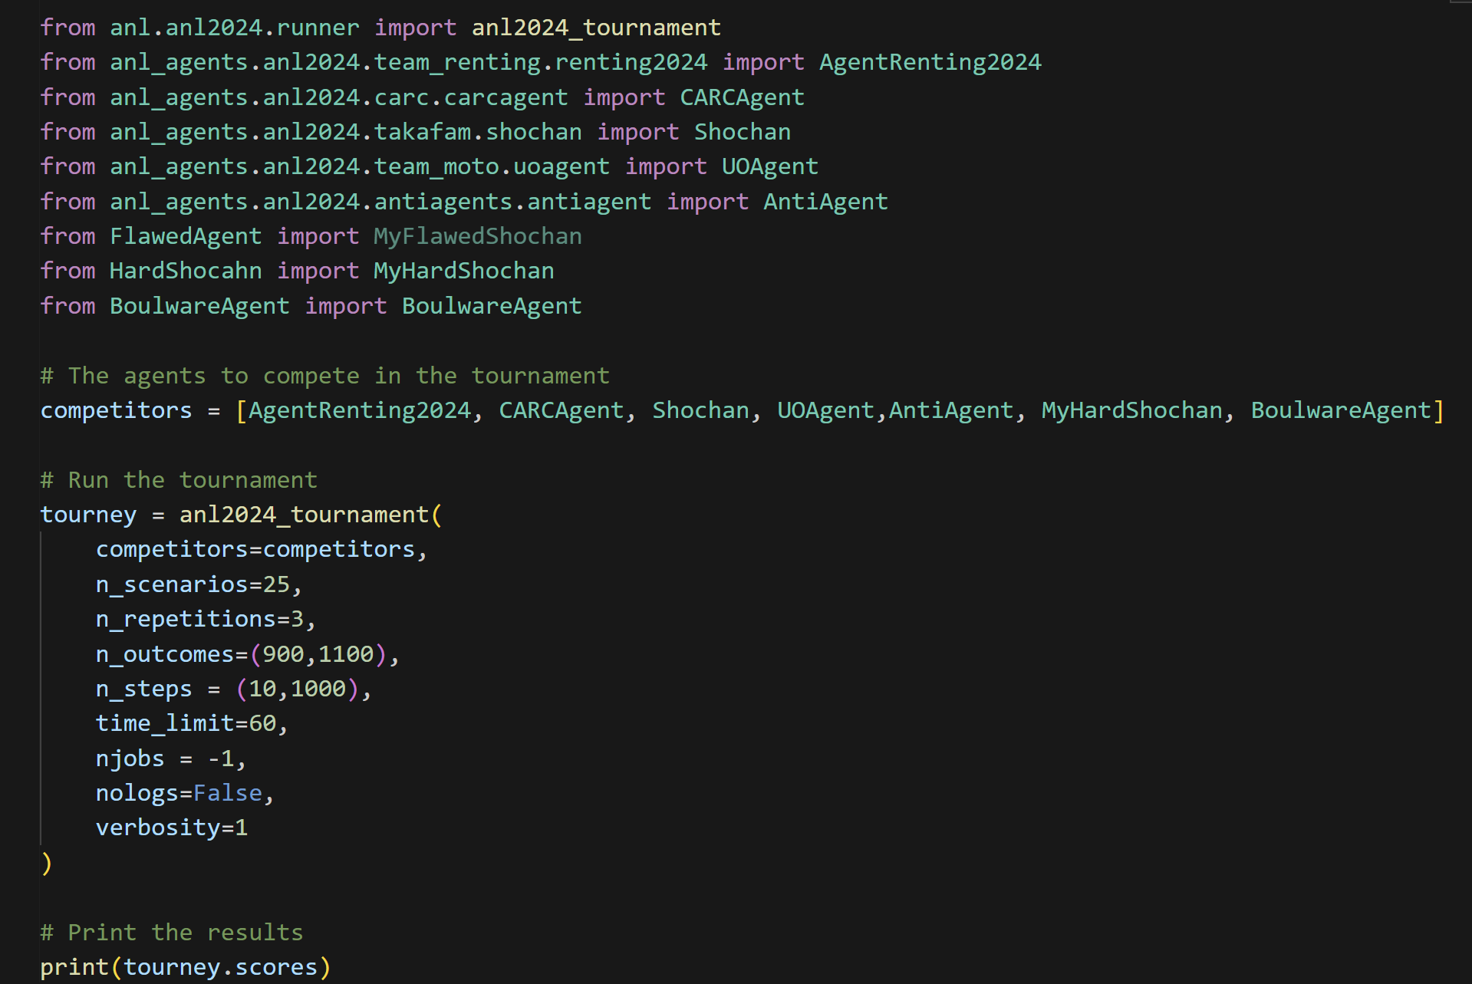
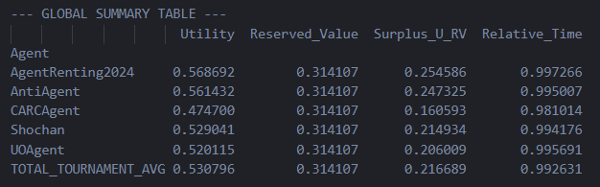
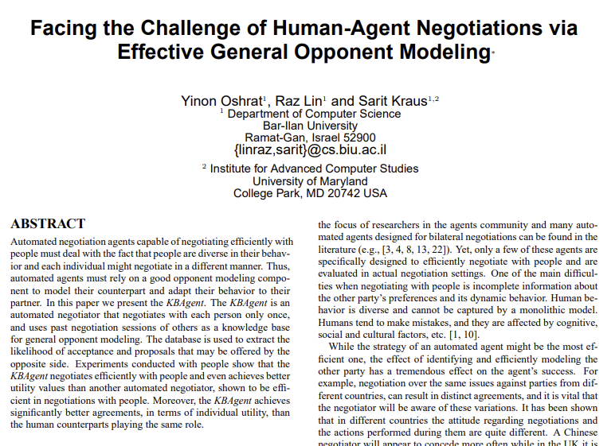
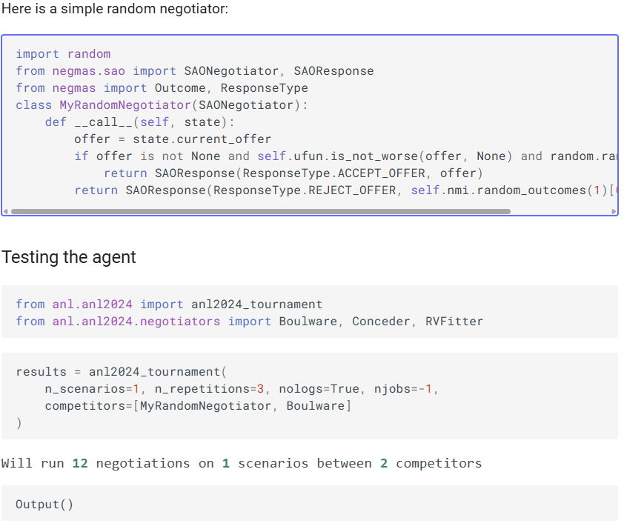
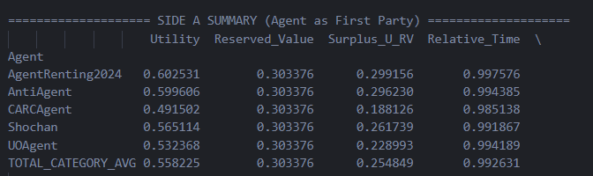
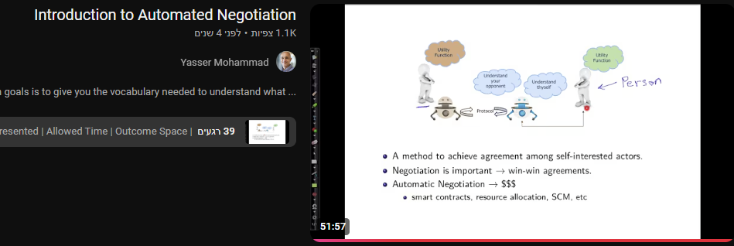
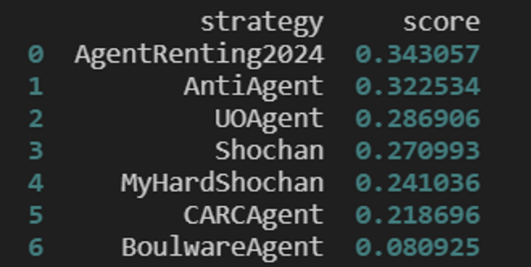
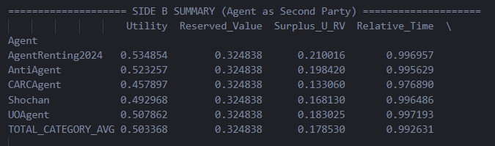
Related Work
Theoretical Learning
Building Agent
Running Tournaments
Conducting experiments

Slide 8
ANL 2024
Protocol: Alternating Offers Protocol (AOP)
Information: Agents have access to their own and their opponent's utility function, but the opponent's reservation value remains private
Special Rule: If the negotiate broke - each agent gets their reservation value
Reservation Value Modeling: Bayesian Learning, Neural Networks, and Linear Regression
Key Winning Strategy:
Last-Chance Exploitation
Bidding Trends

Slide 9
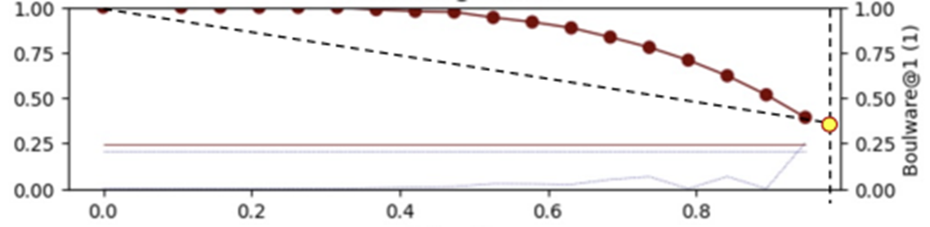
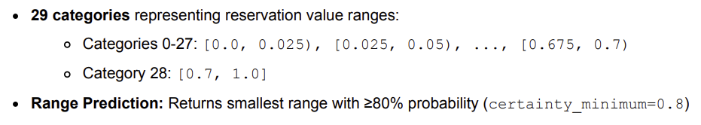
ANL 2024 - Top Agents
Shochan
Core philosophy: "Slow down to maximum, conclude firmly“ - Aiming to reach an agreement at the very last second
Bidding Strategy : Adaptive Boulware Strategy
Opponent Modeling: Target Prediction - it uses Linear Interpolation to predict the opponent's final concession
AgentRenting2024
Core philosophy: Dual strategy that leverages hybrid AI modeling
Bidding Strategy: based on who holds the final offer
Opponent Modeling:
Tactical Curve-Fitting
Strategic Neural Network

Slide 10
ANL 2025
In this multilateral negotiation framework, the tournament features a structure where a single main strategist engages in a series of sequential negotiations with different opponents
The Objective: The goal for the main agent is to reach a desired combination of deals across all separate sub-negotiations to maximize its overall final utility function
Strategic Challenges:
Strategic Coordination: The main strategist must account for the potential utility that may be gained in future interactions and adapt its negotiation approach as it proceeds through the sequence
Future Dependencies: While the main strategist manages the broader multilateral sequence, opponents focus only on the current interaction. Because they have no future dependencies within the series, these opponents can afford to be more assertive
Adaptation: As the sequence progresses, the main strategist may need to transition from assertive behavior to making concessions as options diminish toward the end of the series

Slide 11
ANL 2025 - Top Agents
RUFL (Utility Fit Look-Ahead)
Core philosophy: combines opponent modeling through curve fitting with lookahead search
Bidding Strategy : Reaching an agreement close to the end of a sub-negotiation to get as much information from the opponent as possible
Opponent Modeling:
Extensive form game tree with probability distributions over outcomes
Backwards induction with expected utility propagation
SAC (Soft Actor-Critic)
Core philosophy: The agent uses a pre-trained neural network policy (Soft Actor-Critic style) to determine concession parameters.
Bidding Strategy: Time-based exponential concession strategy.
Opponent Modeling: The agent does not utilize an explicit opponent model, instead, it learns to react strategically by observing context features

Slide 12

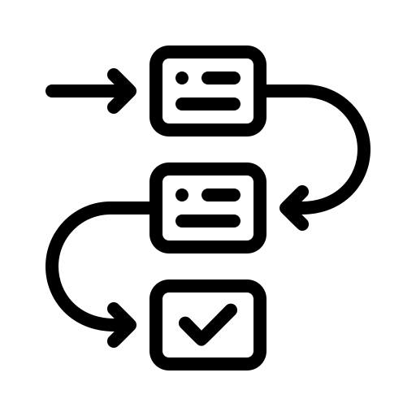
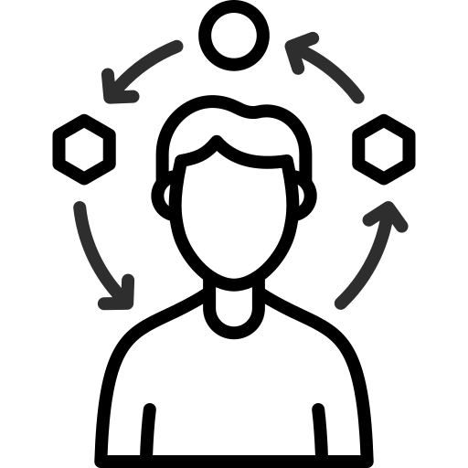
Agents’ Evaluation
Beside competing against other agents, the agents also participate in different scenarios in order to test specific abilities of the agents
One High Score
Planning Ahead
Adaptation & Flexibility

Slide 13
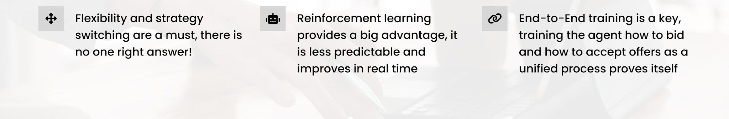

Preliminary Observations
Regarding opponent modeling
Flexibility, agility and strategy switching are a must, there is no single right answer!
End-to-End training is key, training the agent how to bid and how to accept offers as a unified process proves itself
Reinforcement learning provides a big advantage, as it is less predictable and improves in real time
Gathering as much information as possible and being “tough” until almost the end is needed in a time-based negotiation

Slide 14
ANL 2026
A new challenge will be published soon
This year the organizers are considering the usage of LLM
As this is the first time LLMs will be used the effects it will have on agents behaviour and code is yet to be determined or studied

Slide 15
Next Semester Plan
Designing a competitive-nature agent - applying all the insights we’ve discovered
Researching the agent’s score and performance, all while constantly improving and refactoring it
Analyzing the result - statistically, empirically, theoretically, and qualitatively

Slide 16

Thank You For Listening!

